Slide 1
SAY SOMETHING
In 4 out of 5 school shootings, the attacker told people of their plans ahead of time.
March 4-8, WF West High School and Chehalis Middle School will be taking part in the Sandy Hook “Say Something” week.

Slide 2
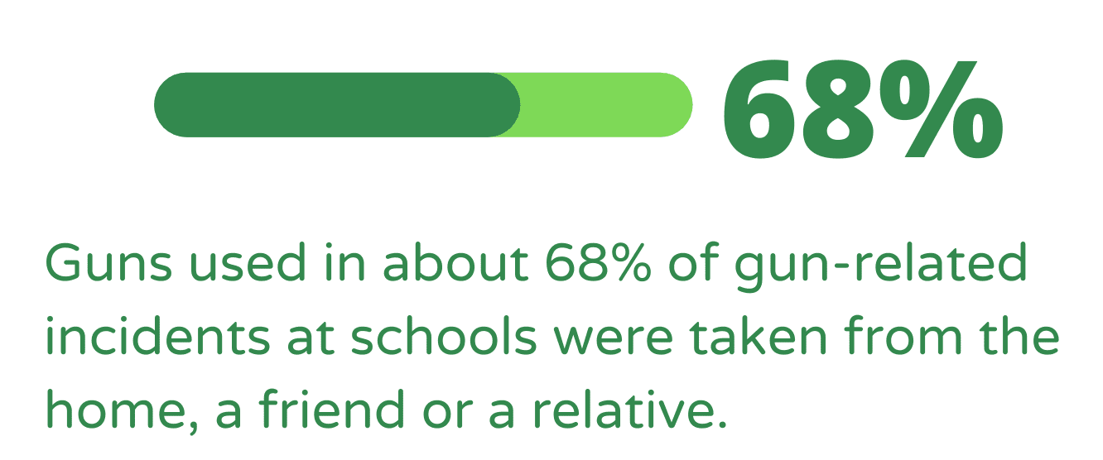
Gun Violence and Warning Signs
Evan, Sandy Hook Promise – YouTube
The film "Evan" by Sandy Hook Promise shows just how easy it can be to miss the signs of gun violence ...

Slide 3
Talk To Your Kids
Recognize the Warning Signs
Take the Pledge

